Slide 1

VOICE 2026 Paper Tips

Slide 2
Topics Covered
01
Paper Confidentiality & Confidential IP
02
Importance of Content & Paper Scoring
03
Suggested Steps for Writing Your Paper
04
Writing Basics, Dos and Don’ts
05
Presentation Formatting & Guidelines
06
Final Reminders

Slide 3
Paper Confidentiality & Confidential IP

Slide 4
VOICE Paper Confidentiality
All the papers at VOICE are classified as confidential IP
  This includes paper title, content, author names and companies
All companies have confidential IP standards that their employees must abide by
The resources used for VOICE should only be used for the purpose they are intended for: to complete your presentation with the best quality possible
  All other uses for these resources are in violation of Advantest confidential IP policies
  These resources include (but are not limited to):
    Teamforge
    VOICE website
    Email
    Resources used at the VOICE event itself

Slide 5
Confidential IP
If possible, customer company names should be left out of papers
  You must have permission to use a customer company name and there is often not enough time to receive it between the final draft and when the paper is presented
Generally, if a customer is an author, consent is implied
A customer company name should not be used if a customer author is not listed on the paper
It advertises how a customer either does something, endorses something, etc. Generally, customers do not want this
Leave out all identifying information from a customer’s data
    Company name
    Device part number
    Directory path (often has company name in it)
    Company initials (example: BCM for Broadcom)
    It should be easy to blank this kind of info out of a screen shot. If you cannot, just flag it on the slide that “xxx needs blanked out”.

Slide 6
Importance of Content and
Paper Scoring

Slide 7
Variations Year-by-Year
The paper selection process is a relative process. What does this mean?
Whether a paper is selected depends on the level and quality of other papers submitted. In other words, if 2026 papers are significantly higher in quality overall, the selection process will be more difficult. So even if a paper is viewed as “excellent,” there may be other papers viewed as “excellent” as well. The criteria then becomes more difficult.
This is why you must keep in mind the other aspects of scoring/rating papers as we will discuss in greater detail shortly.

Slide 8
Motivation of VOICE Attendees
Attendees spend time away from the office as well as company expenses (in some cases, personal expenses) to attend VOICE.
They attend to obtain exclusive understanding of an application, use-case know-how, or technical demonstration from a credible subject matter “expert.”

Slide 9
Content and Scoring/Rating Criteria
Scoring Categories
      Expertise
      Relevancy
      Problem Solving
      Innovation
      Quality

Slide 10
      Expertise (High Degree of)
Ideally, the author of the paper is an “expert” or “subject matter expert”
    Brings credible “know-how”
    “Expert” means someone who has
        Completed the task successfully
        Selected the “best way” to complete the task
        Determined compelling reasons for the selection of the “best way”
        Demonstrated knowledge of the theoretical aspects
It is good to seek out advice from other “experts” to get the best solution
Examples that do NOT demonstrate high expertise:
Did not optimally accomplish the task. Undermines credibility of author -- “know-how” and technical expertise as well as negatively impacts Advantest.
The task was accomplished but the “expert” did not know how he/she accomplished it or why it is the best solution.

Slide 11
Relevancy (High Degree of)
Defined as
How often is this encountered by test engineers?
Often = high relevancy
Rarely = low relevancy
Never = no use / no value
What is the difficulty and importance of the task?
Difficult = high relevancy
Important = high relevancy
Easy / trivial = low relevancy

Slide 12
Problem Solving
Problem-solving examples that are useful and valuable to attendees:
    How to create a stimulus or make a measurement
    How to improve cost-of-test (test time reduction, make test more efficient, improve multi-site efficiency)
    How to develop programs faster (time-to-market)
    How to test a new class of part or new standards (5G, Wi-Gig, IoT, JESD204B/C, etc.)
    New test methodologies
Examples that do not show a high degree of problem solving:
Content that can be found in Advantest documentation, internet, or other conferences is NOT valuable.
Sales, marketing or product showcase materials are NOT valuable.

Slide 13
Innovation
Defined as
New topics (topics never covered/presented before are preferred)
Not done before or rarely done
Important and relevant
Cannot be a “rehash” of material already available. “Re-hash” is defined on the next page.

Slide 14
Innovation – Examples of What We Do NOT Want
“Re-hash” of information
Information on a product/system/instrument pulled from specification sheets or marketing materials
Information that can easily be researched and accessed outside of VOICE (through Google, other industry conferences, from competitors, etc.)
Content that is heavily focused on promoting Advantest products. For example, a presentation that might be used by a salesperson at a customer account for the purpose of pitching for business
Overselling: Content that calls out the solution as being the “best,” “greatest,” “one-of-a-kind,” etc. This is considered marketing/sales jargon. If our solution is the best, it will be demonstrated credibly through the technical content. It does not need to be expressed in these marketing terms.
Papers recently presented at another conference

Slide 15
Quality (High Degree of)
Defined as
“Well rounded”
  Includes problem to be solved, solution, summary
  Optional – theoretical, code examples, DUT board hardware design
Consistency in the paper
  All aspects of the paper topic are covered
  Look and feel of the paper presentation is professional
Use and follow the VOICE template (paper)
  High quality pictures (paper)
  Formatting, i.e., text is lined up, etc.

Slide 16
Suggested Steps for Writing Your Paper

Slide 17
Basic Formula for Writing Technical Papers
01
Use the appropriate template, determine how many slides are needed, and begin writing
02
Identify peers who can perform a technical content review
03
Make sure your company approves any IP content in the paper for publishing
04
Finish first draft and have content reviewed by peers
05
Revise and have content reviewed by peers
06
Host a practice session
07
Check delivery time, speech pace, and knowledge of the material

Slide 18
Step 1: Decide What is Worth Writing About
Do you have knowledge that others need?
  Hours spent explaining can be eliminated if what you know is on paper
  Relevant technical papers become knowledge multipliers to others
Will what you know be forgotten the next time you need it (in 1-2 years)?
  Write important info down and make it usable to others
  Do other peers lack expertise in an area?
    Often, writing about content you have experience with, will make you more of an expert and will benefit others
  If the answer is “Yes” to any of the above, document it by writing a paper!

Slide 19
Step 2: Decide How to Write What You Know
Successful technical papers consist of a two part “package”
PowerPoint Presentation
  Gives a quick injection of knowledge visually
  Should “hit” the major points of the concept and show results, if possible
  The format should be:
    Introduction: “This is what I’m going to say”
    Body: “This is how I’m going to say it”
    Conclusion: “This is how I said it”
Working Code Example or Result
  Code example: attendees can walk away with this as a tool
  Results: go beyond the theory of the paper and prove the point

Slide 20
Step 2: Decide How to Write What You Know
How do you develop the content of your paper/presentation?
Start writing
  The most important thing is to get ideas (whatever they are) on paper
  Start with a crude outline and sub-bullets
  Write down all relevant information you would like to include without worrying about structure, grammar, etc.
2. Edit
  Read through your paper and start to refine your ideas, formatting and sentence structure
3. Gather feedback
  Share your draft and idea with your peers to gather feedback and get suggestions
4. Edit
  Use feedback to make additional edits

Slide 21
Things to Avoid Putting in Your VOICE Paper
Language “bashing” the competition
Competitor company names or product names
Product code words/names that audience members won’t be familiar with
Products that have not been released yet
  There may be special exceptions, but they will require managements approval
Calling a feature a trademarked product name that is not officially a product of the company
  For example, calling a table of information: “Smart Table”
  Unless the company/management have officially approved it and made a press release, it can’t be called this in a paper
Roadmaps on products and/or development
  Talking about “next steps” you will do as a user/developer is OK
Product timeframes, as they change all the time
Deciding to drop a new feature that was on the roadmap – you are handing over to the competition what you are doing in the future

Slide 22
Writing Basics, Dos, and Don’ts

Slide 23
Writing Tips
Abbreviations
First spell out term then add the abbreviation after. Once you have mentioned the abbreviation, you can continue to use it throughout your paper
    Example: Multi-Site Efficiency (MSE). – after that, just use “MSE”
Do not use colloquial/slang or texting abbreviations or terms (e.g. LOL, IMHO)
Remember these papers are archived for the future; will anyone know what they mean in 5 years?
Illustrations
Always reference the same code/circuit/GUI illustration example throughout the paper
    Two illustrations showing the same information will confuse readers
Condense concepts into crystallized ideas
Do not ramble on too much or talk around a point
    This can confuse readers or leave them disenchanted with your paper/presentation
Do not cram many concepts into one sentence when many sentences or paragraphs are required

Slide 24
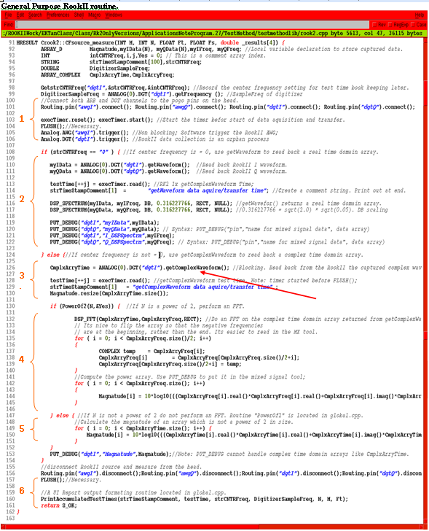
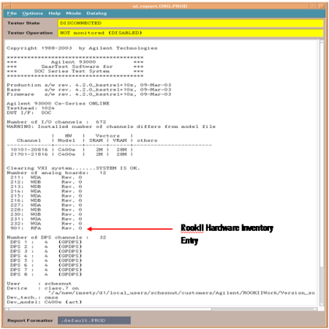
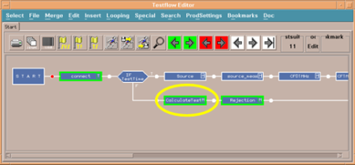
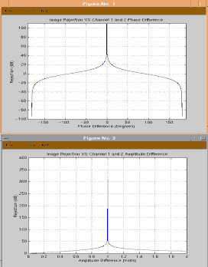
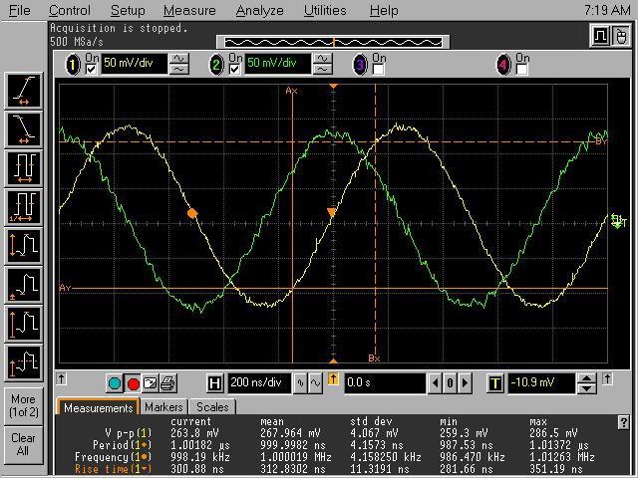
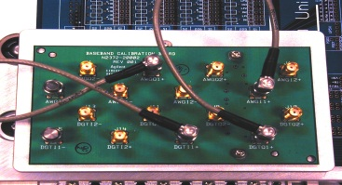
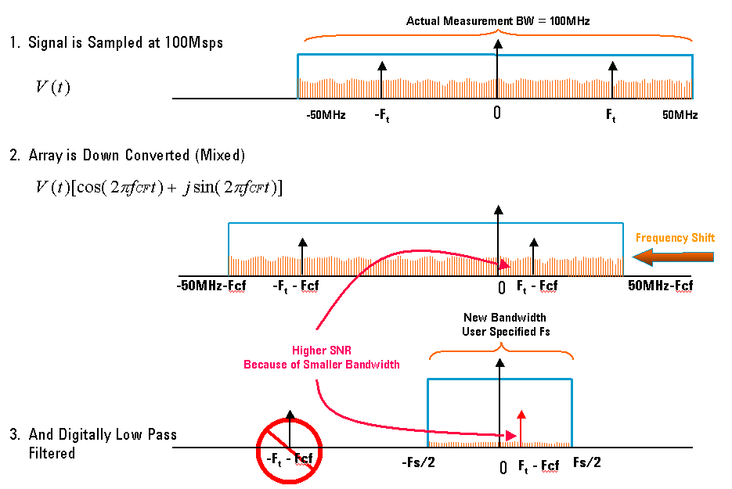
Writing Tips (cont.)
Add as much detail you think is needed
    Readers can skip over what they already know
After explaining the theory behind a concept, go step-by-step through it
Use illustrations of: code snippets / waveforms / schematics / GUI set ups
When the writing is complete, rework the conclusion into the introduction

Slide 25
Writing Dos & Don’ts
DON’T criticize any company’s (even competitor’s) products
DO showcase the advantages of a new way to do something (e.g. saves time, reduces cost)
DON’T hand your competition your weaknesses
DO mention the latest products, solutions, and best practices
DON’T make attendees view older products/services negatively
DO check your facts before presenting
DON’T present outdated or incorrect information as it can lead to a loss of credibility

Slide 26
Writing Dos & Don’ts
DO use the proper commercial name for Advantest and non-Advantest products
  No 93k, v93k,V93k... but V93000, no t2k,T2k but T2000, no ISS or IPS but T2000 IPS/ISS, etc.
DON’T go outside of the editing area defined in the PowerPoint template and overlap with slide title, logo, and footer
DO cite photos used in your presentation taken from the internet (at least include web address)
DON’T make slides too dense or hard to follow
  Slide text is meant to be easily read at a glance
  DO break content (applies text and photos) into 2 slides if necessary
DO use the appropriate IP protection symbols whenever needed (©, ™,®) as these are read by other companies
DON’T FORGET to get any co-authors’ company’s approval
  In most cases a legal department is involved and it takes time

Slide 27
Presentation Formatting & Guidelines

Slide 28
PowerPoint Guidelines
You must use the VOICE PowerPoint template provided to you
There is a minimum requirement of 20 slides although the final number will vary depending on:
  Complexity of the topic
  How fast the presenter speaks (rule of thumb should be 1 minute per slide)
  Under rare circumstances should you try to do more that 1 slide per minute (e.g. if a slide is entirely photos)
If you need a “script” for the presentation, use the powerpoint notes function/view
  Powerpoint : View > Presentation Views > Notes page
You can print out a copy of your notes pages and have them as a backup but, don’t read directly from the notes when you present

Slide 29
Presentation Guidelines
Entertainment
Don’t try to out do Hollywood and overly preform your presentation
We are engineers trying to communicate technical content to other engineers/managers/customers
Humor
Be mindful that most humor is language, culture, and individual dependent
Because of individual’s personal experiences, they may take offense to your humor and that could reflect badly on you and make the audience uncomfortable
If in any doubt: It is not recommended to incorporate humor into your presentation
Eye Contact
Don’t read directly from notes when you are presenting; remember to make eye contact with the audience members

Slide 30
Final Reminders

Slide 31
Final Reminders
Make sure your company approves any IP content in the paper before publishing, including:
  Company names
  Datalog names
  Product names
  Sometimes test parameters
  Complete test lists
  Could even be anything which shows a specific company or product
Your paper should be a “balance” of company specific and generic information
Practice, practice, practice your presentation and make sure you will finish in the allotted time!

